Slide 1
Food Forecasting Analysis
Using Tableau
Mahima Aital

Slide 2
Meal Delivery Company
Problem Statement.
A meal delivery company that operates in multiple cities.
They have various fulfilment centres in these cities for dispatching meal orders to their customers.
The replenishment of the majority of raw materials is done on a weekly basis and since the raw material is perishable, procurement planning is of utmost importance

Slide 3
Data Set Information
We have given the three files in which the data has following information:
Historical data of demand for a product-centre combination
Product (Meal) features such as category, sub-category, current price and discount
Information for fulfilment centres like centre area, city information,

Slide 4
Steps:
Firstly the data set is thoroughly understood, and then been loaded in Tableau File after downloading from source.
Once the data was loaded we saw there was 3 tables, had to blend all 3 tables to get insight information and do analysis by using Blending method.
Once the data was blended then we draw different visualization and insight of the data and conclusion was removed.
Forecasting of total sales with respect to cuisine and centre type was done to understand which cuisine raw materials is needed and which centre need more raw material was drawn.

Slide 5
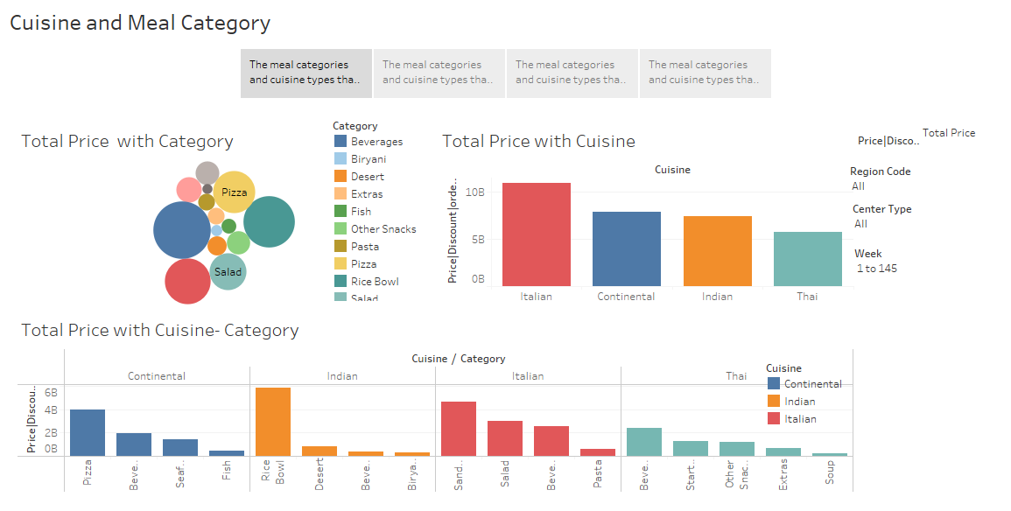
The above slide has Cuisine and meal category story, the drop down at the side allows to check the profit,orders, discount and discount percentage.
We can change the values and see the insight and remove the inference with changing the parameters.

Slide 6
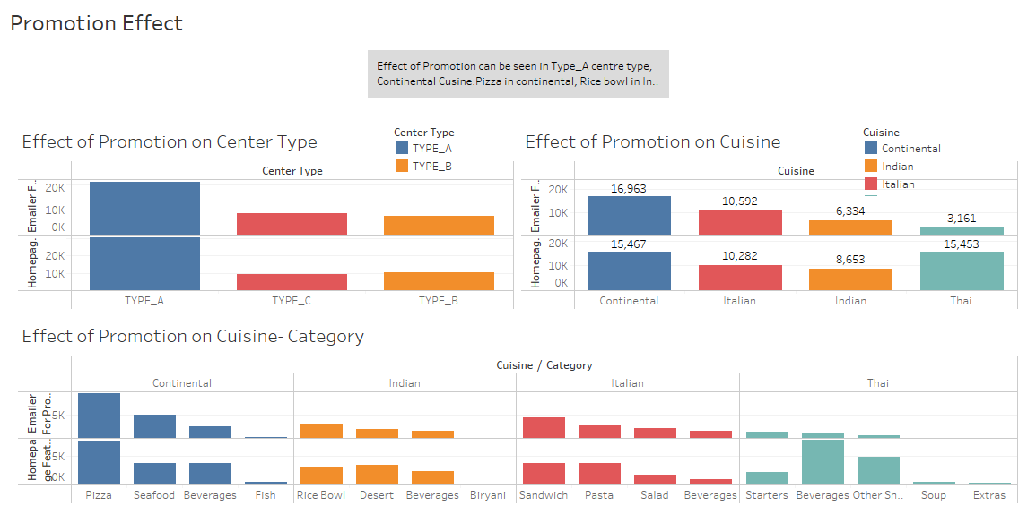
Effect of Promotion can be seen in Type_A centre type, Continental Cusine.Pizza in continental, Rice bowl in Indian, Sandwich in Italian has effect due to promotion either due to Homepage or emailer promotion or both.

Slide 7
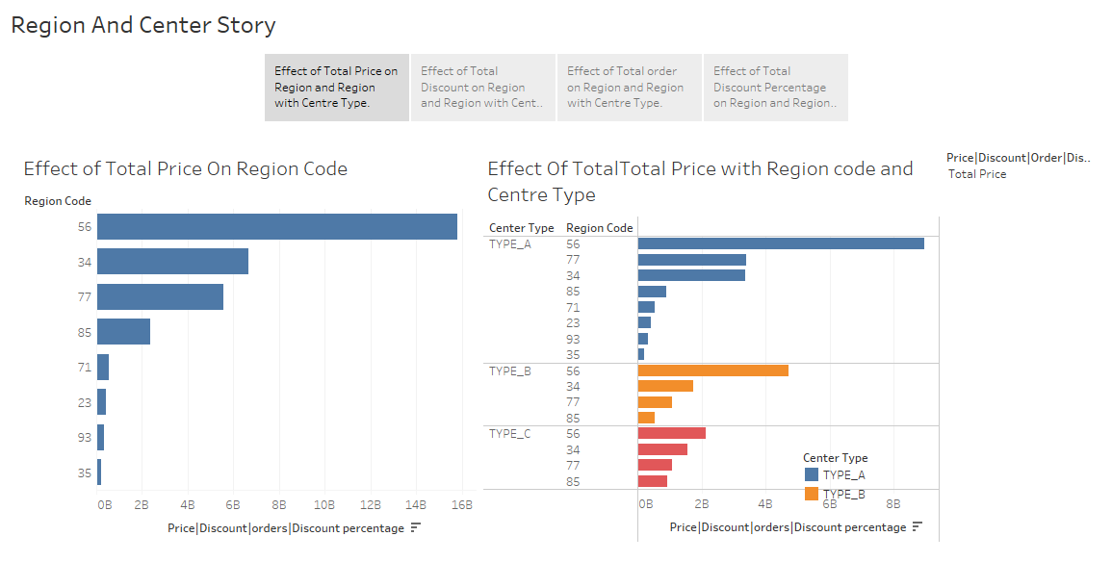

Slide 8
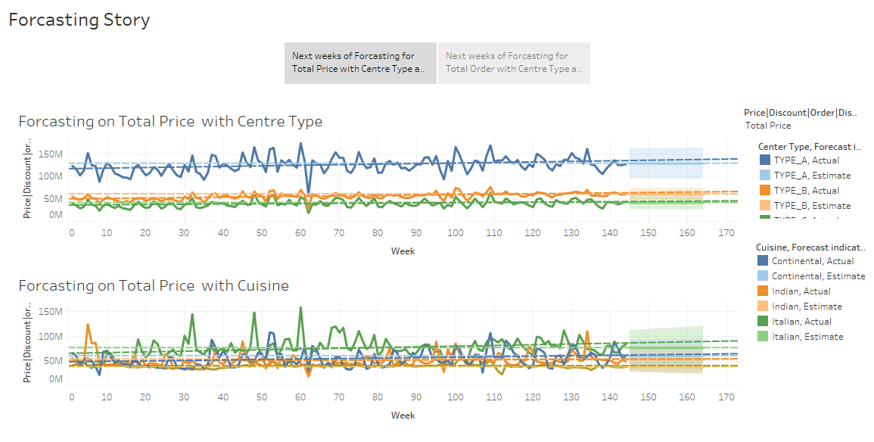

Slide 9
Summary
The meal categories and cuisine types that generate the most revenue are Italian cuisine and the category of beverages.
The meal categories and cuisine types that generate the most order are Italian cuisine and the category of beverages.
The meal categories and cuisine types that offer the highest discounts are Rice Bowl and Continental.
The meal categories and cuisine types that offer the highest percentage of discounts are Seafood and Continental. category of beverages.
Pizza is highest in revenue among Continental Cuisine.
Rice Bowl is highest in revenue among Indian Cuisine.
Sandwich is the highest in revenue among Italian Cuisine.
Beverages is the highest in revenue among Thai Cuisine.
Effect of Promotion can be seen in Type-A center type, Continental Cusine. Pizza in continental, Rice bowl in Indian, Sandwich in Italian has effect due to promotion either due to Homepage or emailer promotion or both.
Effect of Total Price, Total Orders, Total Discount, Total Discount Percentage on Region and Region with Centre Type.
Next weeks of Forcasting for Total Price and Total orders with Centre Type and Cuisine

